Slide 1


Introduction to Optical Networks
Your Optical Fiber Solutions Partner®
All Rights Reserved, Copyright © OFS Fitel, LLC 2017

Slide 2
Agenda
Why fiber?
Optical networks introduction
  Fiber feeds everything
  Brief discussion of 5G
Common FTTH Network Types
  PON
  PTP
PON network design introduction
  Architecture discussion
Optical loss budgeting

Slide 3
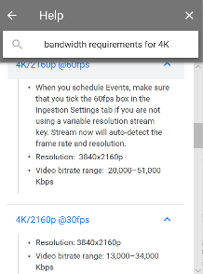
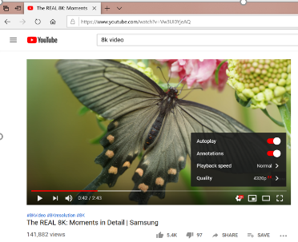
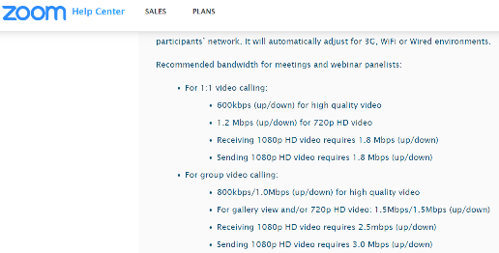
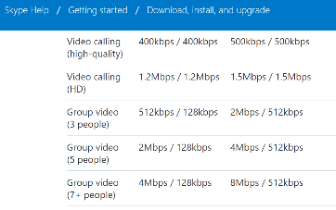

Why fiber in a pandemic? – speed in both directions

Slide 4
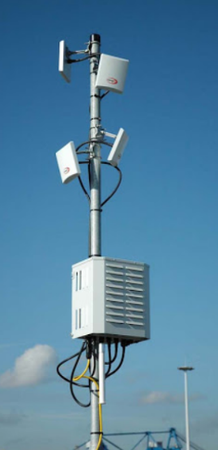
Why fiber in a pandemic?
Flexibility
Fiber enables fast deployment of wired or wireless services
  Underserved areas
  Medical clinics
No fiber, limited service

Slide 5
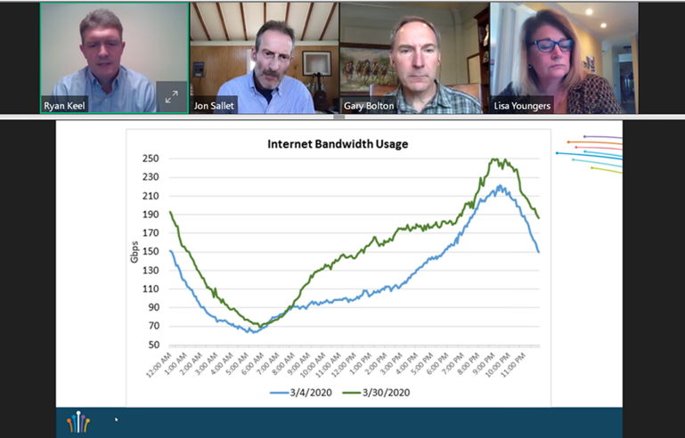
Bandwidth use at EPB - Chattanooga
From Fiber Broadband Association, “Fiber for Breakfast”
EPB Chattanooga internet bandwidth usage from beginning to end of March
Note significant increase, especially during the work/school day!

Slide 6
Why Fiber?
1
Fiber is future proof.
6

Slide 7
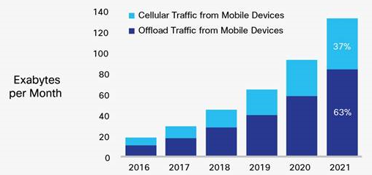
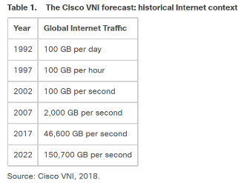
Bandwidth growth is accelerating
In the past 15-20 years, we’ve seen…
  The Internet, iPods
  HDTVs, DVRs
  Smartphones, Tablet computers
  Streaming services
  AI and machine learning
  Connected everything
All require bandwidth
We must expect more bandwidth growth in the future
CISCO BANDWIDTH FORECAST

Slide 8


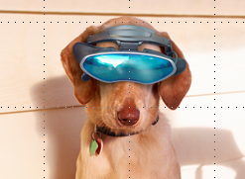
Bandwidth – then, now, and next
Then
25 Mbps
Now
1.5 Mbps
≈ 0.6 kbps
Next
VR >
500 MBPS
9 Mbps
2 Mbps
6 Mbps
8
Notes:
Bandwidth usage has changed. A move from a “broadcast” environment over a single device to an interactive environment over multiple devices.

Slide 9
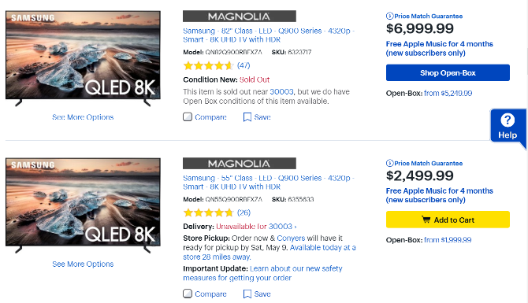
4k and 8K TV
Next generation TV formats
For the first time ever, higher quality video is available via Internet streaming versus standard packages
4K prices dropped rapidly
8K curve just starting
  Main market will be larger screens
SOURCE: OFS PRICE SURVEY

Slide 10
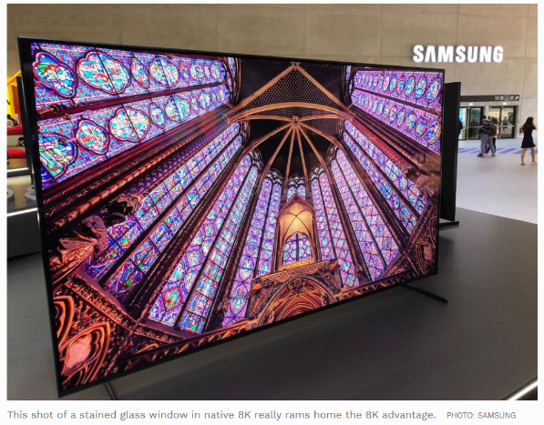
8K TV Review – John Archer, Forbes
“it was instantly and staggeringly clear that all those extra pixels have a stunning and mesmerizing impact on picture quality. The extra detail, the extra color blend refinement, the extra sense of depth and three dimensionality in the assembled shots of nature, cityscapes and a particularly incredible close up of an eye… all these critical image elements added up to a transformative, next-generation picture that looks so lifelike at its best that it arguably doesn’t even feel like a TV picture anymore. It just feels like real life. Only prettier.”
https://www.forbes.com/sites/johnarcher/2018/10/10/samsung-85q900r-8k-tv-review-the-future-is-now/#2319474a4f2b

Slide 11
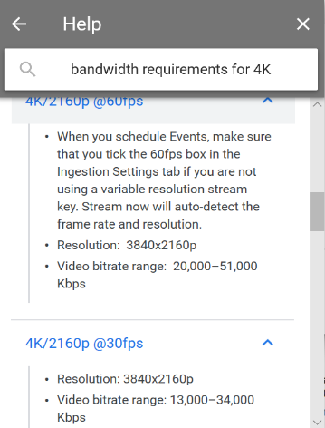


Streaming

Slide 12




Internet of Things and Artificial Intelligence
Image analysis, voice analysis
Natural language – digital assistants
  Language translation
Autonomous vehicles & robotics
Enormous potential for medical improvements using sensors and bandwidth

Slide 13
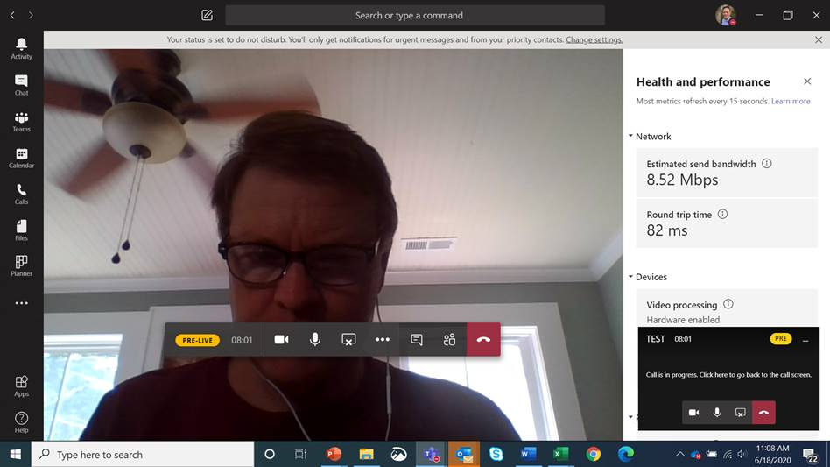
Upstream

Slide 14
Hypothetical household bandwidth needs - Mbps

Slide 15
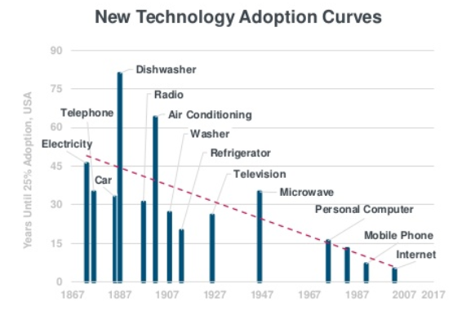
Technology adoption continues to get faster
From Mary Meeker’s (Kleiner Perkins) “Internet Trends 2018” presentation
Time until 25% adoption is dropping dramatically for new technologies

Slide 16
Why Fiber?
More
Bandwidth
Distance
Less
Cost/bit
Size
Weight
Interference
Conductivity (no power needed)
16

Slide 17
Technology evolution
 | Copper | Wireless - Cellular | Fiber
Mid-20th century | Phone grade copper
Early 1980s |  | 1G -2G | Single-mode fiber introduced in early 1980s, still viable and compatible today, 100 Gbps+
Early 1990s | Category 3
1995 | Cat 5
1999 | Cat 5E | 2G-3G
2002 | Cat 6
2009 | Cat 6A
 |  | 4G
2016 | Cat 8
2018-2020 |  | 5G
How Long Will Your Building Last?
Single-mode fiber stands the test of time.
17

Slide 18
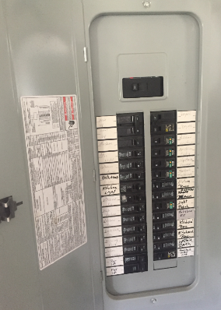
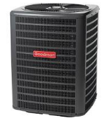



Data is the new power
We can run refrigerators and air conditioners at the same time.
We need bandwidth to meet communications needs also!

Slide 19
Fiber - the core of most phone, cable, power networks
Fiber ring or mesh
Node
Cabinet
Substation
Node
Cabinet
Substation
Fiber
Copper
Coax
Wireless
Node sizes continue to fall
FTTH = Node size = 1
19

Slide 20
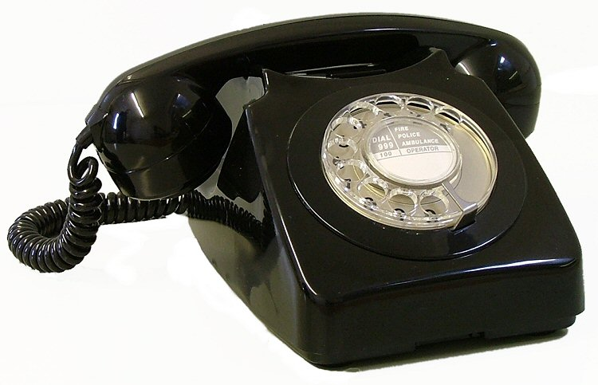


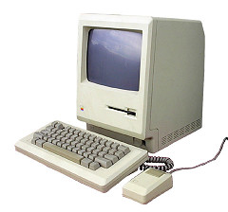
All traffic is converging to “Internet Protocol” and “Ethernet”
PSTN
ATM
SONET
Ethernet
RF/Digital
IP/Ethernet
This Photo by Unknown Author is licensed under CC BY-SA
This Photo by Unknown Author is licensed under CC BY-SA-NC

Slide 21


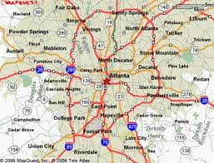





Backhaul Networks
Backhaul Equipment
PON OLT
“Backhaul” refers to the backbone networks feeding end sites
End sites
  Cell towers –
  FTTH equipment cabinets
  DSL equipment cabinets
  Cable modem nodes
Often structured in rings
  Traffic can be rerouted in case of a break
Most commonly 2 fibers
  Variety of wavelengths used
  1550 nm most common, but other wavelengths becoming more important
2 fibers typical per connection
1 fiber typical per connection
Apartment buildings
Office buildings
Stores
Homes
Schools

Slide 22
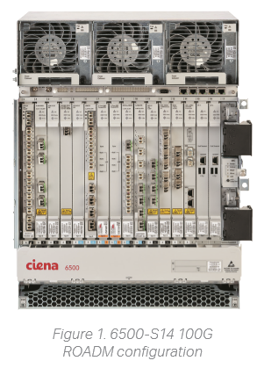
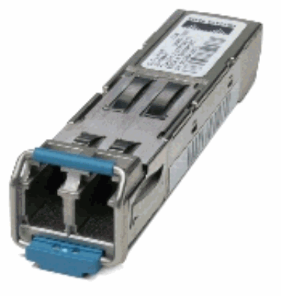
Backhaul equipment
Equipment comes in different shapes and sizes and capacities/functions
Often either 120V AC or 48V DC power
Cooling is very important
Fiber is often connected using a “small form-factor pluggable” (SFP)
  Includes laser and detector
  Vary in speeds, wavelengths, and distances
SFP

Slide 23
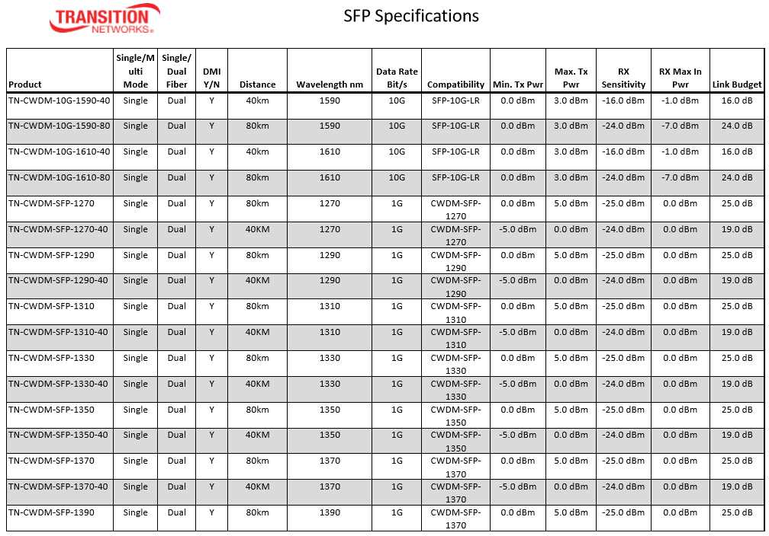
Example SFP specifications

Slide 24
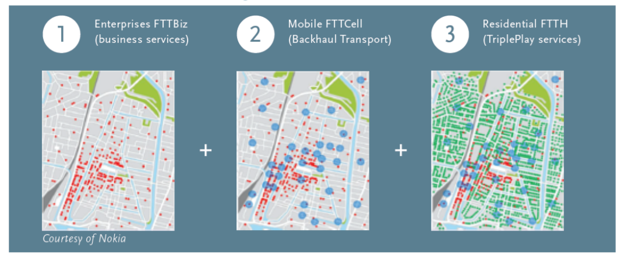
Converged Networks
Notes:
Springboard to 5G
PON/Active/etc.

Slide 25
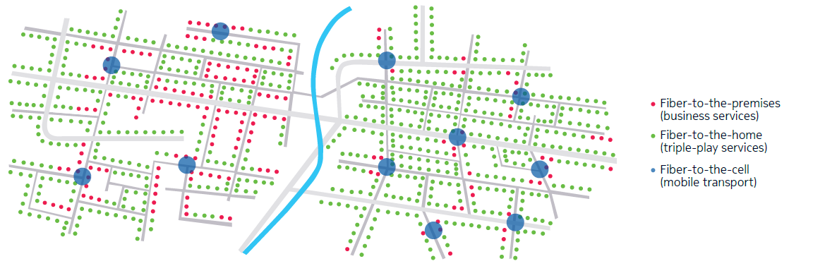
FTTP (Businesses), FTTH, Fiber to Cell Networks deployed in the same space
SOURCE: Nokia_Light_Reading_Fixed_for_Mobile_Transport_White_Paper_EN

Slide 26
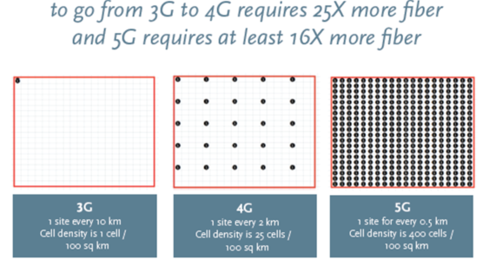
5G is short range so needs more cells and much more fiber

Slide 27
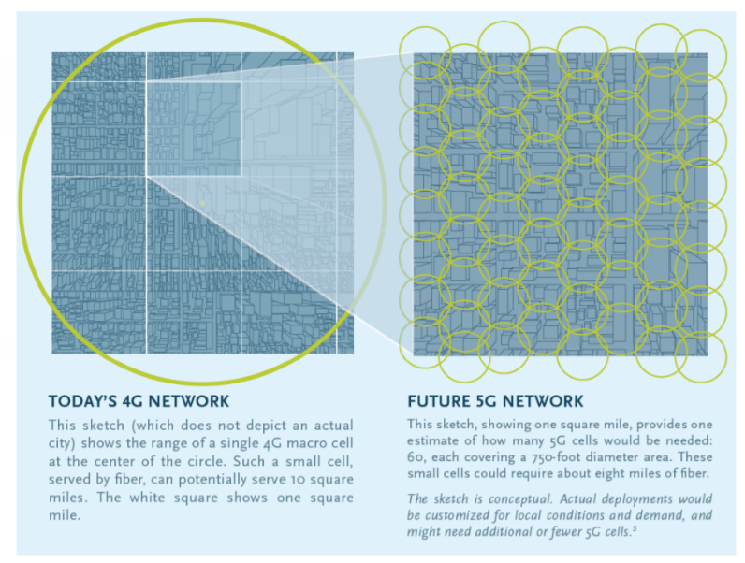
5G is short range and needs more cells – and more fiber
1.4M Miles of fiber cable to fully cover top 25 US Metropolitan Areas
10.4M small cells
750 foot diameter per cell
60 cells per square mile
8 miles of fiber per square mile
Multi-Decade Buildout
Notes:
We don’t expect next year, no business case to support this
Minimum DL link 20 GBPS
Numbers on fiber
Data from congress mobility report

Slide 28
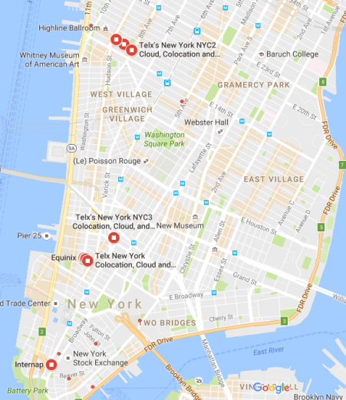
Data Center networks
Data Centers are growing so quickly that they sometimes outgrow the power limitations at a location
Massive amounts of fiber used to connect datacenters relatively close together
Driving demand for very high fiber count cables in small spaces
  Rollable ribbon cables
  Microcables

Slide 29
Typical FTTH Architectures
PON (Passive Optical Network)
Uses a signal divider, such as an optical power splitter
One fiber at the central office feeds many fibers in the field
G-PON (Gigabit PON) and GE-PON (Gigabit Ethernet-PON) are most common
  “Optical line terminal” (OLT) in the central office,
  Optical network terminal (ONT) at the home or business
Point-to-Point (“Active Ethernet”)
One fiber in the head end = one fiber in the field

Slide 30
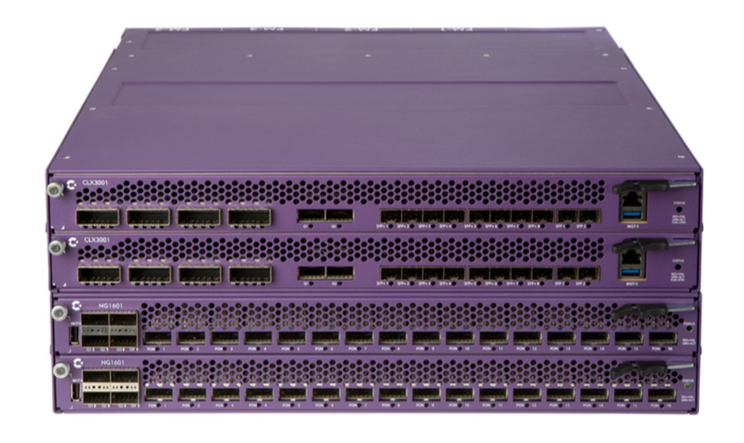
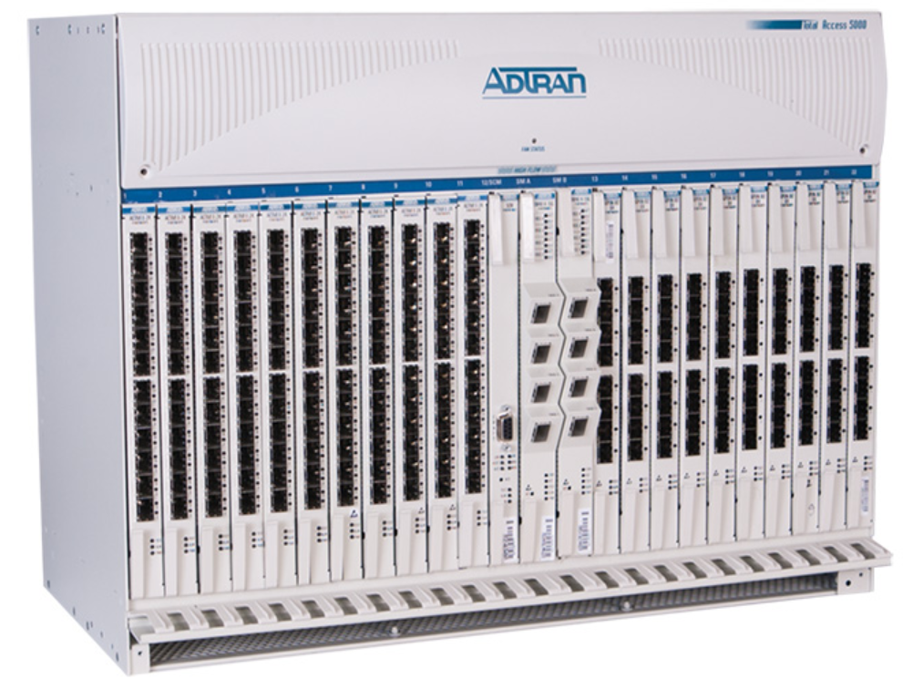
What does an OLT look like?
Power inputs
Bandwidth inputs
  Fiber
  Copper
Fiber outputs
  Called “PON ports”

Slide 31
Access Networks: PON Standards
1310/1270 nm
Late 1990s
IEEE | FSAN
 | A-PON
GE-PON | B-PON
 | G-PON
10GEPON | XGS-PON
 | NG-PON 2
622 Mbps DS
Today
40-100 Gbps proposed
1 fiber per subscriber
Power Splitter
1:32
EDFA
CATV
1490/1577 nm
1550 nm
WDM
OLT
CO/HE
Notes:
First, a quick review of PON architectures In a typical PON FTTH network, there’s an OLT in the central office or remote cabinet, a splitter or combination of splitters somewhere in the field, and ONT at the house.
Something interesting about the wavelengths shown in the upper left hand corner is that although today’s operational wavelengths are the more traditional 1310, 1490 and 1550, tomorrow’s wavelengths include those plus 1270 and 1577. Cable companies doing RFoG (RF over Glass) may also use 1590/1610 for the return path upstream from the settop box.

Slide 32
Typical FTTH Architectures - 2020
 | GPON |  | GE-PON |  | Point to Point (Active Ethernet)
 | Current Gen | Next Gen | Current Gen | Next Gen
Downstream Bandwidth | 2.4 Gbps total | 10 Gbps total | 1.2 Gbps total | 10 Gbps total | 100 -1000 Mbps per sub
Upstream Bandwidth | 1.2 Gbps total | 10 Gbps total | 1.2 Gbps total | 10 Gbps total | 100 -1000 Mbps per sub
Typical distance | 20 km | 20 km | 20 km | 20 km | 20 km
Wavelengths (nm), Downstream Upstream | 1490 1310 | 1577 1270 | 1550 1310 | 1577 1270 | 1550 1310

Slide 33
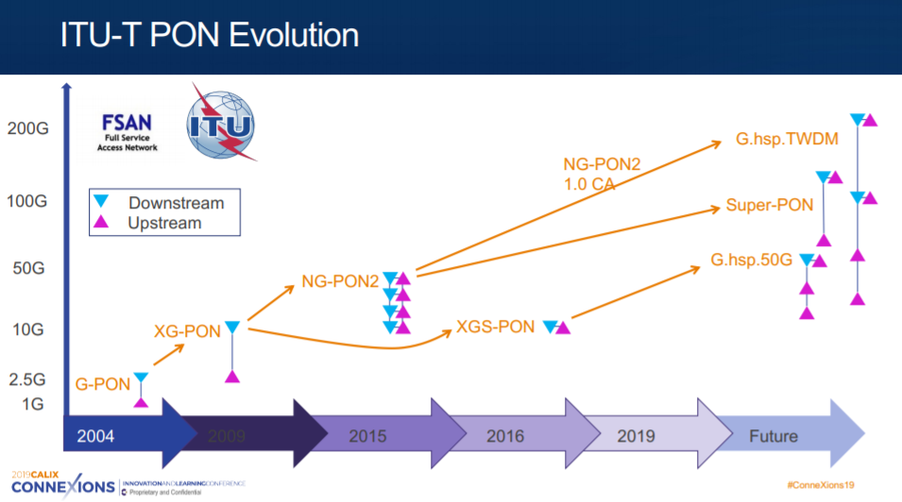
PON is scalable

Slide 34
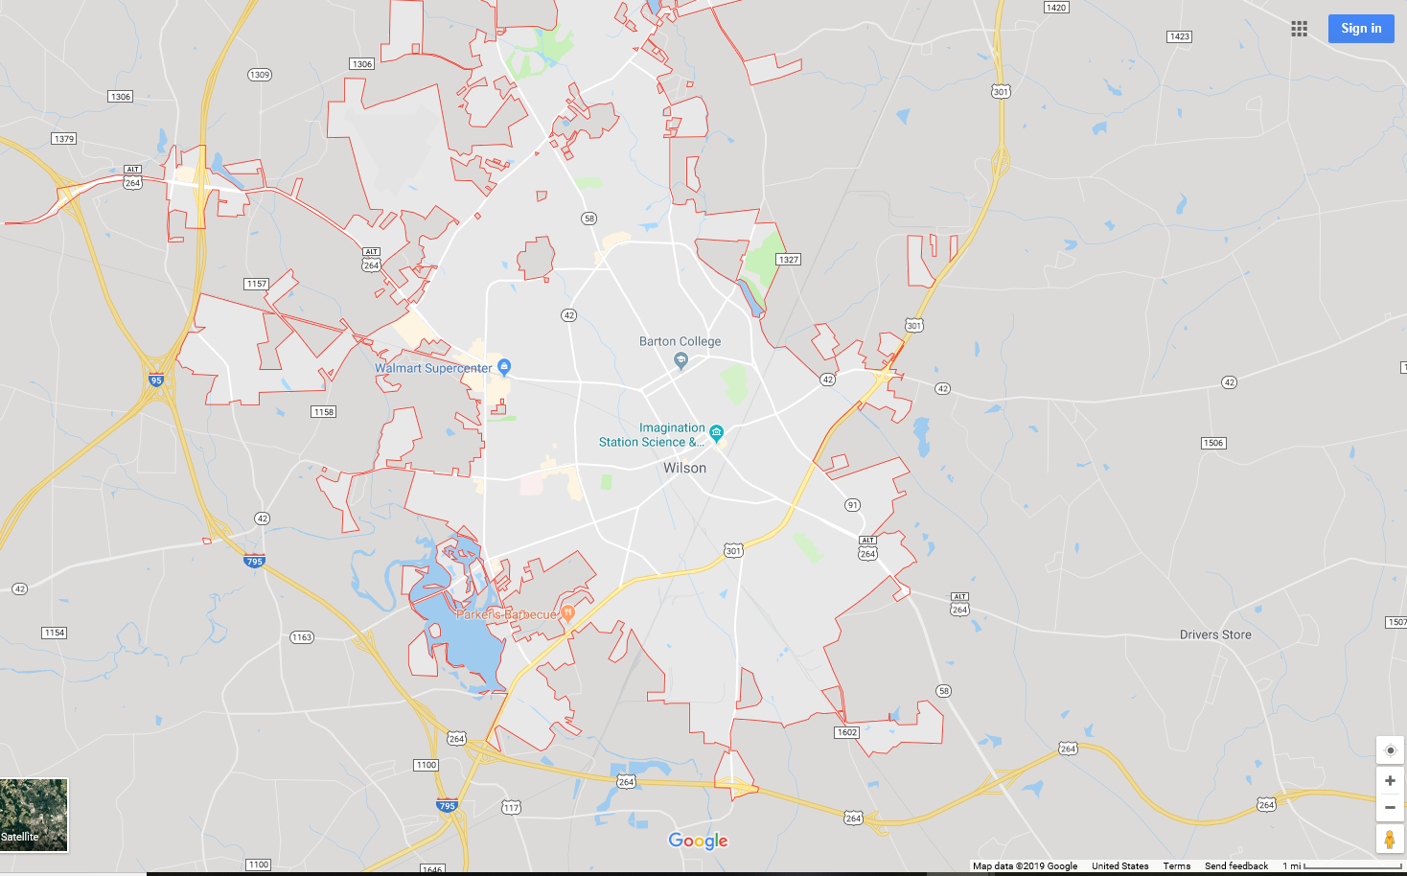
What does 20 km (12 miles) look like?
Wilson, NC
  49,000 population city
  81,000 population county
Entire area could be served by one area
Have 2 for additional service and redundancy
20 km/12 miles

Slide 35
PON vs PTP
PON
  Fewer fibers in the “F1” area
  Significant equipment space reduction
  Significant power use reduction
Point to point
  Potentially higher bandwidth (should discuss)
  Possibly more fibers, depending on the building configuration
  Often simpler network management configuration for smaller networks
For larger networks, electronics suppliers often offer chassis that offer both configurations

Slide 36
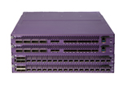
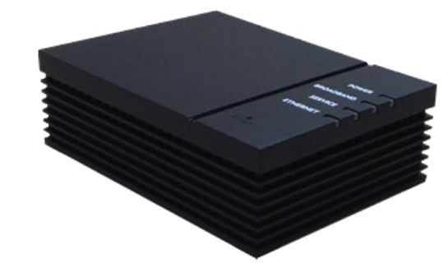
PON – Less flexible, but more scalable
Variety of access points available, from the same manufacturer
Theoretical cross-manufactured PON interoperability - Still limited on a practical basis
Used for majority of larger scale network builds
Typically requires separate management server
Calix E9-2
Calix 801G GigaPoint

Slide 37

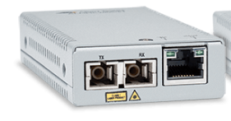

Point to Point Networks – flexibility, but at a price
PTP networks give more flexibility
  Higher speeds
  Potentially longer distances
  Customized services
Plant is more expensive
Powering is more expensive
Uses much more space
Can mix and match components on either end
Allied Telesis x220-28GS
Telco Systems Metrobility R200
Allied Telesis MMC series

Slide 38
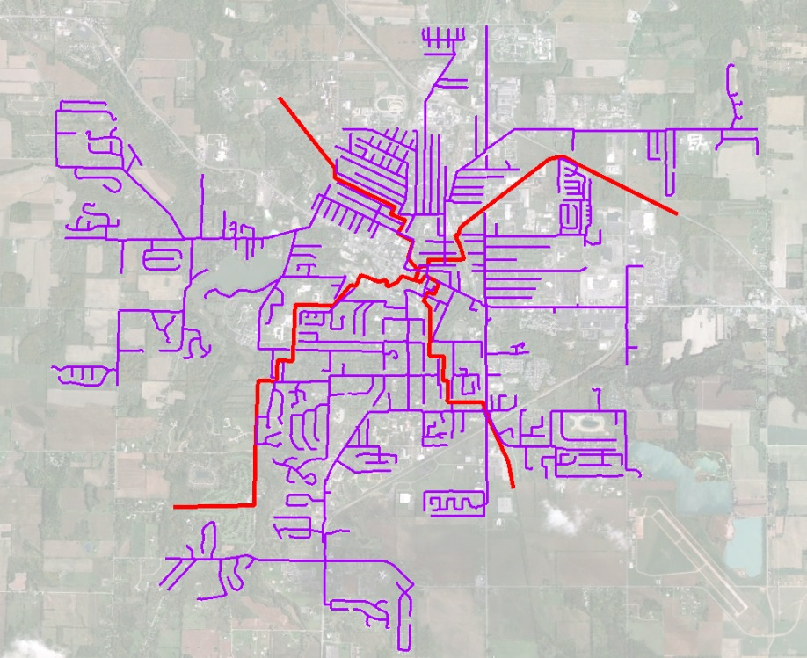
FTTX Network Planning
Establish Ultimate Network Plan
Network Plan Objectives
Reduce installed costs
Increase speed of network build
Increase return on investment
  Target network segments based on ROI
Streamline build cost estimation process
Example Network Plan
Cable route design for 10k premise network
38

Slide 39
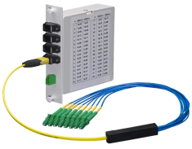
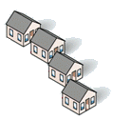
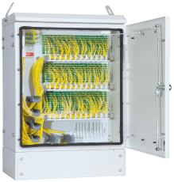

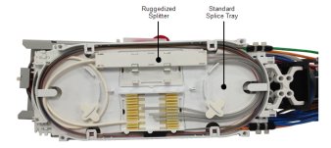

Where to place the Splitter- 3 options
Home Run (Centralized with splitters in the CO)
Closure
Centralized (FDH)
Splitters In Cabinets
Closure
Distributed
Splitters In Closures
Notes:
Mark
The biggest decision with regard to splitters is where to place them. Once this decision is made, the actual splitter type becomes relatively obvious.
Please note that there is no law that says that once you place splitters in one manner, you need to follow that convention throughout the network. Be flexible and let the network topology and operational considerations dictate the best option.
The three most typical choices are the to place the splitters in the central office, in a centralized cabinet, and to place them in closures. We’ll give a quick overview of each and will cover them in detail, including pros and cons, later in the webinar.
Placing the splitters in the central office is often done in small towns and to service customers that are relatively close to the OLT. Please note that in this discussion, the term central office or CO is synonymous with remote cabinet, so this applies when using remote cabinets also.
The second main deployment option is known as centralized splitting in a fiber distribution hub or cabinet. In this case, multiple splitters are placed in the field in one cabinet serving up to hundreds of subscribers.
The final method is known as distributed splitting. This method places individual splitters in closures relatively close to the end users.
One item to note is that OFS offers a training program with in-depth discussion of advantages and
Disadvantages of different splitter placement protocols.

Slide 40
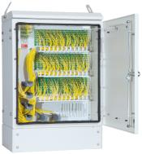

Splitter Location, Packaging, and Homes Passed
Choice driven by take rate, density, and distance from CO
High
Distributed Splitting
1:32 in terminal fusion spliced serving 32 home area
FDH CENTRALIZED Splitters – 144 – 432 Home Area
0 2 4 6 8 kft
Housing Density
Distributed splitting becoming more attractive as OLT prices decrease
Distance from headend
Splitters in CO
Low
Take Rate % after 18 months
80 70 60 50 40 30 20 10
Notes:
David
This is a slide showing some general guidelines for splitter location and packaging. OFS has a series of pretty elaborate cost models that we’ve used to develop these recommendations.
Let’s talk about this a little more, because once you begin to think about it a little bit, it becomes somewhat intuitive.
Working from right to left on the slide…
If you expect subscription or take rates to be low, then it’s best to place splitters in a single centralized location, either in the CO or in a fiber distribution hub. We’ll cover FDHs later in the presentation. A rough guideline is to place splitters in the CO if the majority of customers with 2500’, and in an FDH beyond that distances Since you don’t know where subscribers are coming from, placing splitters in a centralized location will allow you to maximize the efficiency of the PON ports.
However, there’s a breakeven point associated with this exercise. As PON port pricing comes down and the overhead costs of the cabinet stay relatively constant, it becomes more economical to distribute the splitters in individual closures. The breakeven point is roughly 50%-60% subscription rate. Keep in mind that you can have different types of splitter delivery systems in the network if certain parts of the network will sign up faster than others.

Slide 41
FTTX Architectures
PON - Central Office Splitting
Requires largest cables and most splicing
Maximizes OLT port utilization
Utilized in dense urban deployments
41

Slide 42
FTTX Architectures
PON - Cabinet Splitting
Closely resembles copper networks
  Cross connect cabinets
Most common method of deployment in U.S.
42

Slide 43
FTTX Architectures
PON - Distributed Splitting
Greatly reduces cable sizes and splicing
Requires more OLT ports than CO or cabinet splitting
  Typical break-even take rate is 20-25%
43

Slide 44
Distributed Splits
Enables use of smaller fiber counts
Place splitter in the middle of 32 customers
  16 fibers in each direction
Can use 24 or 36 fiber cable as distribution cable
Re-use distribution fibers for each splitter
Splitters in Closures or Pedestals
16 fibers
1x32
16 fibers
Drop
Drop
Drop
Drop
Distributed
Notes:
David
To this point, we’ve mainly discussed centralized splitting, in a central office, remote electronics cabinet, fiber distribution hub or MDU setting.
Now, we’re going to turn our direction to distributed splits. Newcomers to the fiber world sometimes don’t know that distributed splits are an option, since much of the marketing focus is around fiber distribution hubs. However, the method has many advantages for certain types of networks.
The term distributed split basically means that the splitters are not all in one location, and that the splitters are distributed geographically throughout the network. This also means that they’re often closer to the end customer.
There are 2 different types of distributed split scenarios, distributed 1x32 splits and distributed splits that are cascaded 1x2, 1x4, 1x8, and 1x16 splits.
Some advantages of distributed splitting is that it can be significantly less costly than a centralized design. Overall, it requires less splicing, and less installation time since an installer doesn’t need to come back to the splitter as part of an installation. Finally, smaller fiber counts can be used with distributed split models, leading to better utilization of the fiber investment versus a network with fiber distribution cabinets.
The biggest disadvantage is PON port utilization with low subscriber counts. In addition, the network is more complex since splitters are scattered through the network requiring very good recordkeeping.
Two more minor issues are that troubleshooting can be more difficult if splitters are cascaded, and it requires a different design technique when compared to copper designs.
Overall, it’s a very interesting and an approach that more companies should consider.

Slide 45
FTTX Architectures
PON - Cascaded Splitting
Minimizes cable sizes and splicing
Ideal for rural deployments
45

Slide 46
FTTX Architectures
Active Ethernet (Active E) or Point-to-point (P2P)
Requires largest cables and most splicing
Highest cost of electronics per customer
Maximum bandwidth per customer
46

Slide 47
Splitter cabinet or node
Where to place them?
10
32 HOME
PON AREAS
The ideal place is the middle of the service area
Also true for drop closures
Sounds simple…not always done
Saves significant money on fiber count and cabling infrastructure

Slide 48
Ideal Cabinet placement
144 homes
Cabinet placed here
Cabinet placed here
36 fiber cables used
72 fiber cables used

Slide 49
FDH Homes Passed vs. Total Cost
256-288 is the sweet spot
Ideal FDH Size (Homes Passed)
Cost Drivers: Longer Average F2 Cable Placing/managing many FDHs
Ideal for most densities – 256-288 Homes Passed
High density
Rural/Low density
Homes Passed per FDH
NOTE: Varies by Density and other factors
Notes:
Mark
As part of OFS’ modeling efforts to understand the best ways to deploy splitters, the sweet spot for many networks is one cabinet per every 256-288 homes passed, which lends itself nicely to a 288 fiber count cabinet.
With higher cabinet counts, the additional cable cost needed to reach the extra subscribers, since they’re farther away from the cabinet, tends to drive up the cost.
With lower cabinet counts, the placing costs go up, unless the area is more rural or has lower density. In that case, lower cabinet capacities can be economical.
Please note that these numbers, like all of what we highlight, are not hard and fast rules, but rather general guidelines based on the experience we’ve had over the past decade being involved with FTTH projects.

Slide 50
Distributed Splits
Advantages and Disadvantages
Two Types
  Distributed 1x32 splitters
  Distributed cascaded 1x2, 1x4, 1x8, 1x16
Distributed Advantages:
  Less costly than centralized design
  Eliminates technician visit to splitter upon install
  If splitters are fusion spliced, less install time since installer does not have to visit splitter
  Better utilizes fiber investment by reusing dead fibers
Distributed Disadvantages:
  Less efficient use of electronics with low subscription rates
  Different record keeping required vs centralized
  If spliced, troubleshooting must occur from the home
    Home is the likely first stop anyway
  Requires a different design technique compared to copper design
Splitters in Closures or Pedestals
Distributed
Notes:
David
To this point, we’ve mainly discussed centralized splitting, in a central office, remote electronics cabinet, fiber distribution hub or MDU setting.
Now, we’re going to turn our direction to distributed splits. Newcomers to the fiber world sometimes don’t know that distributed splits are an option, since much of the marketing focus is around fiber distribution hubs. However, the method has many advantages for certain types of networks.
The term distributed split basically means that the splitters are not all in one location, and that the splitters are distributed geographically throughout the network. This also means that they’re often closer to the end customer.
There are 2 different types of distributed split scenarios, distributed 1x32 splits and distributed splits that are cascaded 1x2, 1x4, 1x8, and 1x16 splits.
Some advantages of distributed splitting is that it can be significantly less costly than a centralized design. Overall, it requires less splicing, and less installation time since an installer doesn’t need to come back to the splitter as part of an installation. Finally, smaller fiber counts can be used with distributed split models, leading to better utilization of the fiber investment versus a network with fiber distribution cabinets.
The biggest disadvantage is PON port utilization with low subscriber counts. In addition, the network is more complex since splitters are scattered through the network requiring very good recordkeeping.
Two more minor issues are that troubleshooting can be more difficult if splitters are cascaded, and it requires a different design technique when compared to copper designs.
Overall, it’s a very interesting and an approach that more companies should consider.

Slide 51
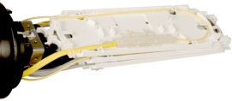
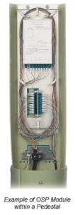
Distributed splitting options
When to use
Design in 32 customer PON segments
Higher expected subscription rates
  <40%-50%
Rural areas
  Cascaded splits can be helpful to decrease fiber counts
Ruggedized splitter in a splice tray
Splitters In Closures
Distributed
Notes:
David
In terms of offerings, OFS offers different types of splitters for distributed splitting. These include bare splitters, which are mainly recommended for indoor use, ruggedized splitters that can be placed in splice trays, and the DirectConnect splitter that we’ve shown several times during the presentation.
The Direct Connect slender design makes it an excellent choice for space challenged areas, including boxes, pedestals or closures.

Slide 52
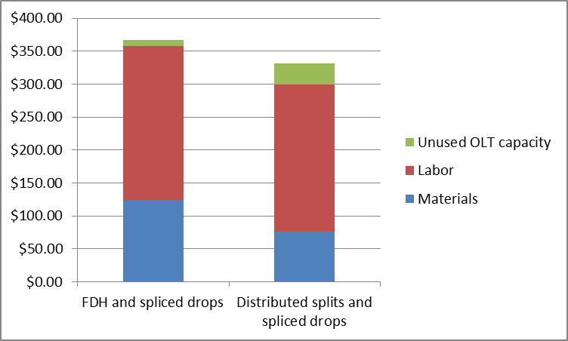



Distributed splits are sometimes a better choice
Cost to pass 256 homes and connect 80 homes
FDH CENTRALIZED Splits
Distributed Splitting
Distributed splitting is more attractive as OLT prices decrease
0 2 4 6 8 kft
Distance from headend
Splitters in CO
Take Rate % after 18 months
80 70 60 50 40 30 20 10
52

Slide 53
Summary
PON and PTP have different pros/cons
Many customers use both as “tools in a toolbox”
  PON – Typically used for bulk of residential subscribers
  PTP – Often used in conjunction with PON to serve special, higher value business customers
The fiber doesn’t care which is used
Often wise to build in extra capacity to enable flexibility to offer either service as appropriate.

Slide 54
Optical Loss Budgeting
The primary design factor used to determine if the network will work!!!
Other parameters to consder:
  Reflectance – specify APC when needed
  TDMA window (if applicable) - stay within defined distance parameters
Optical loss budgets are based upon “worst case.” Use maximum loss values for all components.
  Often significant safety margin that can be used if needed

Slide 55
Optical Loss Budget: Design Budget
The sum of max loss values at applicable wavelengths for all passive components plus splice loss:
  Cable length (dB/km @ wavelength * length)
  Insertion loss for connectors (connector pairs)
  Splitters
  Insertion loss for WDM’s (where applicable)
  Splices
  Environmental/restoration margin
    Lots can happen in 40-50 years
Max loss values for components typically from vendor specifications and/or industry standards
  Often significant safety margin throughout all components

Slide 56
Optical Loss Budget
Loss budget:
10 to 27.5 dB @ 1490 nm
13.5 to 29 dB @ 1310 nm
At 1490: 7 dBm + 3 dBm = 10 dB
2 dBm + 25.5 dBm = 27.5 dB
At 1310: 4.5 dBm + 9 dBm = 13.5 dB
29.5 dBm – 0.5 dBm = 29 dB
Optical Output: -0.5 to +4.5 dBm
Sensitivity: -3 to -25.5 dBm
Optical Output: +2 to +7 dBm
Sensitivity: -9 to -29.5 dBm

Slide 57
Example 1

Slide 58
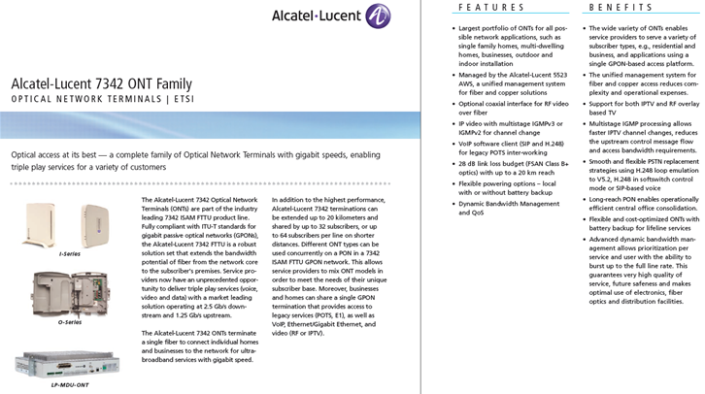
Example 2

Slide 59
Optical loss components – Fiber and cable
Water absorption peak may be higher or lower for a given fiber
1260
1360
1460
1530
1565
1625
Wavelength (nm)
Performance at critical PON wavelengths
  1490 – 0.27 dB/km
  1310 – 0.35 dB/km
Next generation PON – 1577 and 1270 nm
  1577 – roughly 0.23 dB/km
  1270 – roughly 0.40 dB/km

Slide 60
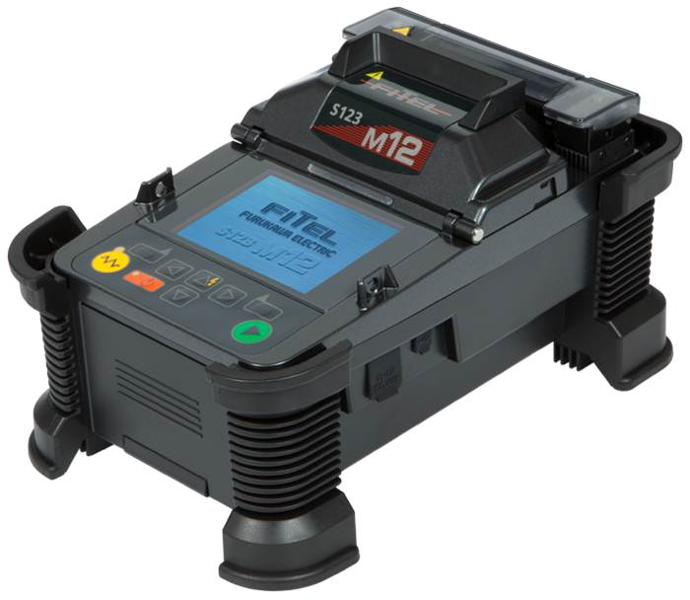
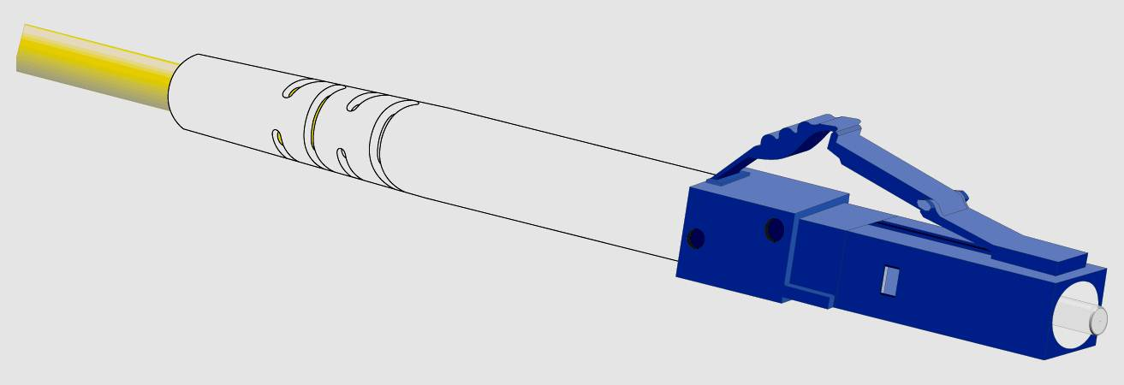
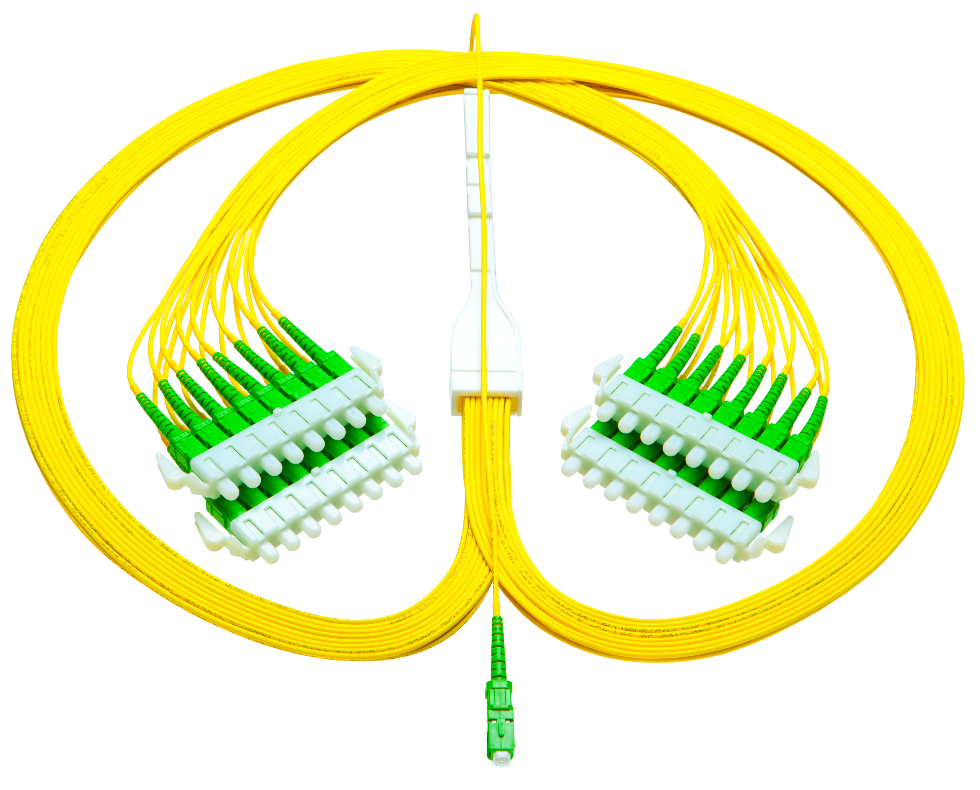
Splices connectors, splitters
Splices – typical 0.05 dB
  Performance can depend on fiber quality, splicer type, attention to detail
Connectors – typical 0.25 dB
Splitters (1x32) – typical 16.5-18 dB

Slide 61
Bend insensitive math
For drops, bend loss is more important than splice loss
In-Residence Drop Cable Loss vs. Fiber type
Attenuation Loss Component , 1550 nm (dB) | G.652D | G.657A2 | EZ-Bend ® fiber
Inherent fiber loss (100m) | 0.03 | 0.03 | 0.03
Attenuation due to bending in the Verizon MDU Drop Cable Simulation (TPR-9424) | Dark (>30 dB) | 2 to 5 (midpoint, 3.5) | <0.2
Splice loss (1 splice to G.652 fiber) | 0.02 | 0.04 | 0.09
SC-APC to SC-APC Connector Loss (0.15/connection, 2/link) | 0.30 | 0.30 | 0.30
Attenuation total or typical link status | Over 30 (Link will not work) | 3.87 (Likely to create link failure) | 0.62 (Well within acceptable limits)

Slide 62

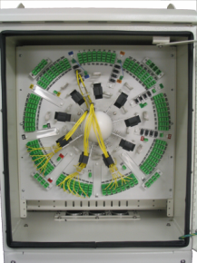
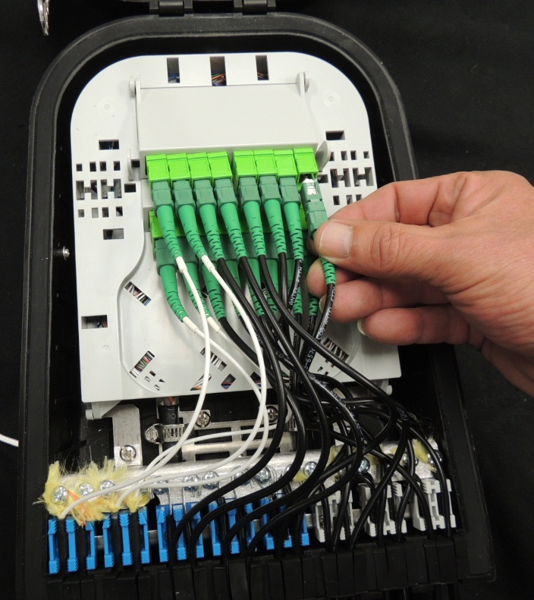
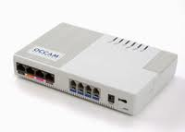

Putting it all together
28 dB loss budget
CO Splice
Component | Loss | Length or Number | Total (dB)
X
Fiber Cable | 0.35 (1310 nm) | 20 km | 7
Trunk mid-network splice(s)
X
X
Splices | 0.05 | 7 | 0.35
Splitter (1x32) | 17 | 1 | 17
FDH splices
Connectors | 5 | 0.25 | 1.25
X
In-home bending (EZ Bend) | 0.4 | 1 | 0.4
Feeder mid-network splice(s)
X
Total | 26.00
X
Drop or Terminal splice
X
Home splice or connection

